Slide 1
Project #0: Installing Pintos
[CSE4070]
Instructors
Prof. Sungyong Park (01)
Prof. Youngjae Kim (02)
Teaching Assistants
Yoochan Kim (01)
Joseph Ro (02)
Fall 2023
Notes:
Class PT

Slide 2
Linux Instructions and Vim Usage

Slide 3
Useful Linux instructions
man
mkdir/rmdir
cp
mv
rm
cat
echo
grep
ps
kill
pwd
su/passwd
tar
Notes:
본문

Slide 4
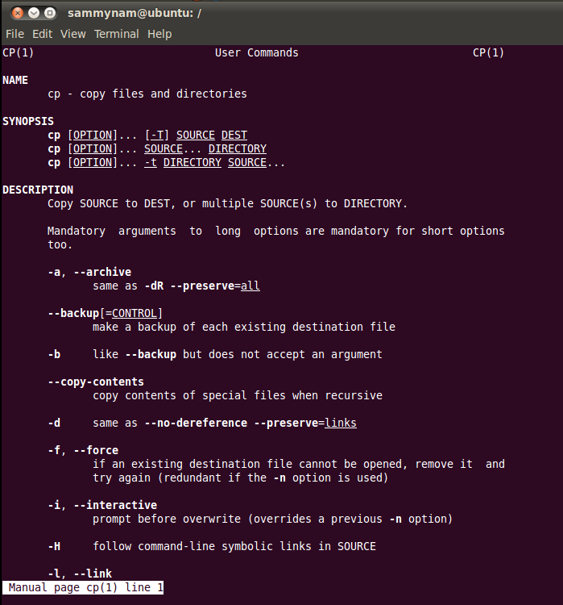
man
Provides description and usage for Linux commands
Usage: man [instruction]
Ex:
$ man cp
Notes:
본문

Slide 5
mkdir/rmdir
Make/remove directory
If the directory is not empty, use 'rm -r' to remove it
Usage: mkdir [option] [Directory Name]
rmdir [option] [Directory Name]
Ex:
$ mkdir temp
Notes:
본문

Slide 6
cp
Copy the file (Original file is preserved)
Usage: cp [option] [src] [dst]
Ex:
$ cp a.c temp
Notes:
본문

Slide 7
mv
Move file or rename file (Original file is disappeared)
Usage: mv [option] [src] [dst]
Ex:
$ mv a.c b.c
Notes:
본문

Slide 8
rm
Remove file or directory.
Usage: rm [option] [filename]
Ex:
$ rm –rf temp
If you perform 'rm -rf *' in /(root) directory, every file will be deleted from the system.
-rf option indicates recursive and force, respectively.
Notes:
본문

Slide 9
cat
1. Print the contents of the file on the standard output.
Usage: cat [option] [filename]
Ex:
$ cat tempfile
$ cat > test.txt (Get data from standard input; user can input data until user does [Ctrl+D])
$ cat < test.txt (Print the contents of the file)
2. Concatenate files
Ex:
$ cat test.txt test2.txt > test12.txt (Concatenate test.txt and test2.txt and make a file “test12.txt”)
Notes:
본문

Slide 10
echo
Prints string or system environment variables.
Usage: echo [string…]
Ex:
$ echo $PATH
$ echo x
Notes:
본문

Slide 11
grep
Print lines matching a pattern from files or standard input.
Usage: grep [option] PATTERN [File…]
-n: print the line and line number in FILE which is matched.
-i: ignore case distinctions.
-l: print only FILE name, which contains PATTERN matched.
Ex:
$ grep –n ftp /etc/groupt
$ grep –i the /etc/init.d/qmail
$ grep –il ftp /etc/init.d/*
Notes:
본문

Slide 12
ps
Report the list of current processes.
Usage: ps [option]
-ef: print the all processes with full-format listing.
-au: print the username and start time of processes including other users' processes.
Ex:
$ ps -ef
$ ps –au
$ ps
Notes:
본문

Slide 13
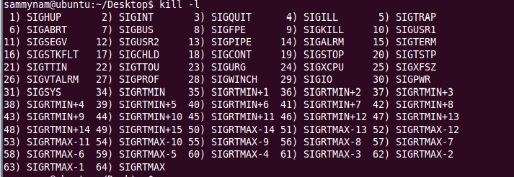
kill
Sends signal to the processes.
Representative signal is SIGKILL which is used to forcefully terminate a process.
Usage: kill [option] [process id]
-l: print list of signals
Ex:
$ kill -9 4914 (force quit process #4914)
Notes:
본문

Slide 14

pwd
Checks the current directory.
Usage: pwd
Notes:
본문

Slide 15
su/passwd
su: switch user ID or become superuser.
passwd: change user password.
Usage: su [options] [username]
Ex:
$ su (if the USERNAME is omitted than it will switch the account to the superuser.)
$ passwd (change the password of current account.)
Notes:
본문

Slide 16
tar
Compresses or extracts file.
Usage: tar [options] [pathname]
-c/x: compress / Extract
-v: verbosely list the files processed
-f: use the file to compress or extract
Ex)
$ tar -cvfz sample.tar.gz pintos (if pintos is a directory, it will be compressed into sample.tar.gz)
$ tar -xvfz sample.tar.gz (extract sample.tar.gz)
Notes:
본문

Slide 17
vim
Vim is known as Visual Interface iMproved, which is an improved version of vi
Normal mode:
yy+p: copy and paste line, /: search, x: delete character, dd: delete(cut) line, u: undo.
v : change into visual mode.
Insert mode
i : Insert, a : Append
Execution mode (Type ': (colon)' in normal mode)
w: save, q: quit, q!: quit without saving
Insert
Exec.
esc
:
esc
i/a/o/u/s
Normal
Launch vim
Notes:
본문

Slide 18
Data Structures

Slide 19
Data Structures in Pintos Kernel
Before we dive into Pintos project, we will practice Pintos data structures.
Pintos provides kernel and user libraries.
You can find it in "pintos/src/lib/kernel" and "pintos/src/lib/user"
In this project, we will cover data structures of Pintos kernel libraries. → List, Hash table and Bitmap

Slide 20
List
List in Pintos is a doubly linked list.
It is different from usual list structure.
It splits list element pointers and data.
struct list_elem
Each structure that will be a list item must embed a struct list_elem member.
All the list functions operate on list_elem, not the list item.
Only list_elem structure is given in the source code.
You must implement new structure that consists of list_elem and data.
head
elem
elem
elem
tail

Slide 21
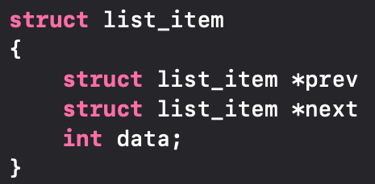
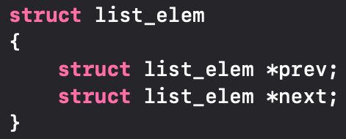
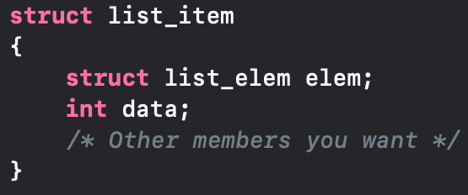
List
Linked List: Usual way
Linked List: Pintos kernel
list_item
list_item
*prev
*prev
*next
*next
int data
int data
list_item
list_item
list_elem elem
list_elem elem
*prev
*prev
*next
*next
※
int data
int data
Split the pointer and data
※ 'struct list_item' is not given in the source code, you need to implement it.

Slide 22
List Function Analysis
void list_init(struct list *list)
Initializes LIST as an empty list.
It should be executed before an element is inserted in LIST.
struct list_elem* list_begin(struct list *list)
Returns the first element of LIST.
Usually used to iterate the LIST.
struct list_elem* list_next(struct list_elem *elem)
Returns the next element of ELEM.
Usually used to iterate the LIST or search ELEM in the LIST.

Slide 23
List Function Analysis
struct list_elem* list_end(struct list *list)
Returns the last ELEM in the LIST.
Usually used to iterate the LIST.
#define list_entry(list_elem, struct, member)
Converts the pointer to LIST_ELEM into a pointer to STRUCT that LIST_ELEM is embedded inside.
Usually used to get address of STURCT which embeds LIST_ELEM.
sample_list
*e
list_elem head
*temp
/* Assume that there already exists a list, sample_list */
struct list_elem *e;
e = list_begin (&sample_list);
struct list_item *temp = list_entry(e, struct list_item, elem)
int temp_data = temp->data
By using list_elem, we can get address of list_item
*prev
*next
list_elem elem
*prev
*next
list_elem tail
*prev
*next
int data
struct list_item

Slide 24
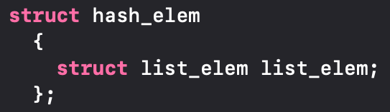
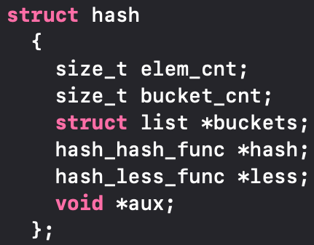
Hash Table
A hash table is a data structure that associates keys with values.
The primary operation is a lookup.
Given a key, find the corresponding value.
It works by transforming the key using a hash function into a hash.
※ Assume that key and value are same.
Key
Buckets
Entries
0
prev
100
1
head
next
tail
f(x)=x/100
2
100
Need to implement.
Refer struct list_item.
550
3
4
prev
prev
500
5
head
next
next
tail
6
500
550
7

Slide 25
Hash Table Function Analysis
void hash_init(struct hash *h, hash_hash_func *hash, hash_less_func *less, void *aux)
Initializes hash table H and sets hash function HASH and comparison function LESS.
You can see the example of hash function such as hash_int, hash_bytes, and hash_string. (You have to use hash_int function to pass the test.)
Comparison function LESS is used to compare two hash elements.
void hash_apply(struct hash *h, hash_action_func *action)
You can apply any ACTION function which you made to hast table H.
Used for applying specific function to all elements in hash table. e.g.) square function.
You can learn the usage of it from 'hash_apply.in' and 'hash_apply.out' in tester directory.

Slide 26
Hash Table Function Analysis
#define hash_entry(hash_elem, struct, member)
Converts pointer to HASH_ELEM into a pointer to STRUCT that HASH_ELEM is embedded inside.
Usually used to get address of STURCT which embeds HASH_ELEM.

Slide 27
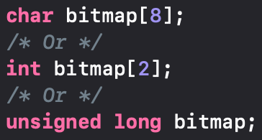
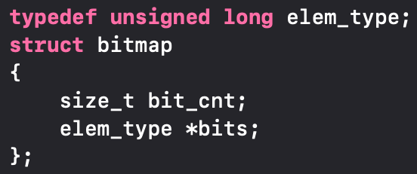
Bitmap
A bit array(or bitmap, in some cases) is an array which stores individual bits (Boolean values).
A bitmap can reduce the waste of memory space.
I
N
T
E
G
E
R
I
N
T
E
G
ᐧᐧᐧ
E
R
I
N
T
E
G
E
R
I
0
0
0
1
0
0
0
1
0
0
0
0
ᐧᐧᐧ
0
1
0
0
0
1
0
0
0
0
256 Bytes (2048 bit)
8 Bytes (64 bit)
Bitmap: Usual way
Bitmap: Pintos kernel

Slide 28
Bitmap Function Analysis
struct bitmap *bitmap_create(size_t bit_cnt)
Initializes a bitmap of BIT_CNT bits and sets all its bits to false.
void bitmap_set (struct bitmap *b, size_t idx, bool value)
Atomically sets the bit numbered IDX in B to VALUE.
size_t bitmap_count (const struct bitmap *b, size_t start, size_t cnt, bool value)
Returns the number of bits in B between START and START + CNT, exclusive, that are set to VALUE.
3
7
0
0
0
1
0
0
0
1
0
0
0
0
ᐧᐧᐧ
0
1
0
0
0
1
0
0
0
0
bitmap_count(b, 3, 4, 1) == 1
8 Bytes (64 bit)

Slide 29
Pintos Installation

Slide 30
Caution
We will use CSPRO9 (cspro9.sogang.ac.kr) and CSPRO10 (cspro10.sogang.ac.kr)
So do not try to run Pintos on CSPRO (cspro.sogang.ac.kr) server
Note that the CSPRO server indicates CSPRO9 or CSPRO10 from now on
Notes:
본문

Slide 31
Pintos & Emulator
Pintos is simple OS framework for 80x86 architecture.
Use system simulator that simulates an 80x86 CPU and its peripheral devices.
Project Category : User Programs, Kernel Threads, Virtual Memory, File Systems.
Features
Support user and kernel thread.
Allow running user program (basic UNIX commands like echo, ls, cat, pwd, …).
Support simple file system.
Implemented in C language.
Well-Documented Project & Grading System.
We will use QEMU as an emulator for Pintos.
Notes:
본문

Slide 32
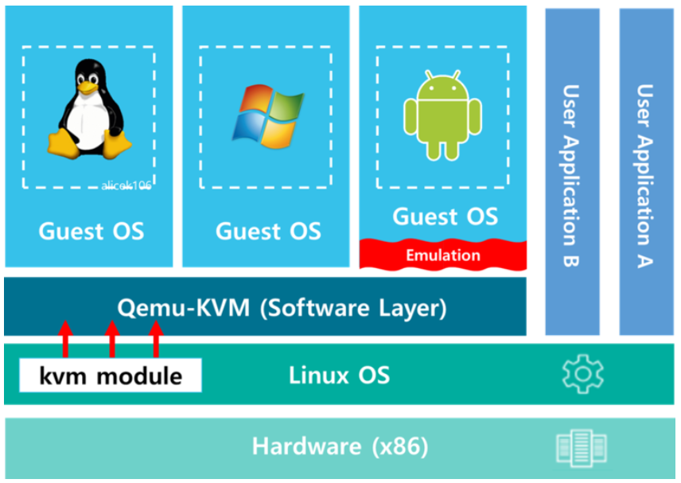
Pintos & Emulator
Both KVM and Qemu are virtualization solutions for the Linux OS. The reason KVM and Qemu are installed together is that KVM and Qemu have a complementary relationship.
"Virtualization" is to provide functions such as kernel translation and resource distribution through a hypervisor to run an OS that can use the hardware in a virtual machine.
"Emulation" is the implementation of hardware in software to provide a specific execution environment.
Notes:
본문

Slide 33
Pintos Installation
Download Pintos file
We provide modified code in e-class, so don't use original source code from Stanford University.
Extract the file
$ tar -xvzf pintos_modified.tar.gz
You don't need to install QEMU in the CSPRO sever. It is already installed.
Notes:
본문

Slide 34
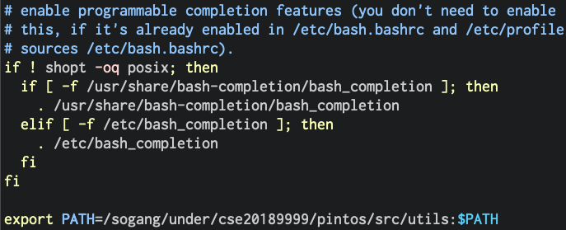
Pintos Installation
Before running Pintos, we need to setup .bashrc file in the home directory
Open ~/.bashrc with editor.
Add the following line at the end of the file: export PATH=/sogang/under/<YOUR_ACCOUNT>/pintos/src/utils:$PATH (학부생) export PATH=/sogang/grad/<YOUR_ACCOUNT>/pintos/src/utils:$PATH (대학원생)
Run the following command to apply the changes in bash shell: $ source ~/.bashrc
Notes:
본문

Slide 35
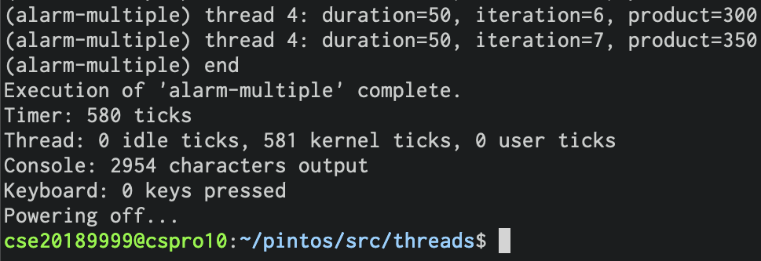
Running Pintos
Build Pintos (assume that you have already extracted the file on your home directory)
$ cd ~/pintos/src/threads
$ make
Consequently, 'build' directory will be created in the current directory (src/threads).
Run Pintos
Pintos provides 'pintos' utility that helps running Pintos by QEMU.
'pintos' utility is in src/utils.
Go to src/threads and run the following command (you should run it in src/threads, not src/utils).
~/pintos/src/threads $ ../utils/pintos -v -- -q run alarm-multiple Or ~/pintos/src/threads $ pintos -v -- -q run alarm-multiple (Note that you should input one space among '-v (turn off VGA)', '--' and '-q (quit after execution')
Notes:
본문

Slide 36
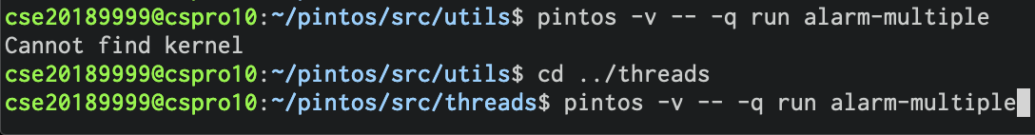
Running Pintos
If you face the error like below, check the current directory where you run pintos.
Since the current directory is src/utils, Pintos cannot find its kernel and error occurs.
If you execute Pintos in src/threads, Pintos will find the kernel in src/threads/build/kernel.bin
Notes:
본문

Slide 37
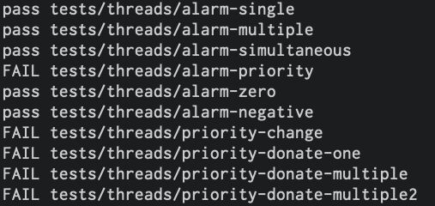
Project Test
Each project has its own test program
Test program is in src/tests.
You can use this program to test your implementation by yourself.
For example, in project 3, you can test by running 'make check' in src/threads/
~/pintos/src/threads $ make check
PASS/FAIL will be printed for each test case
※ src/threads/build/results
Notes:
본문

Slide 38
Requirements

Slide 39
Project #0
In CSPRO9 or CSPRO10 (not CSPRO) server, run $pintos -v -- -q run alarm-multiple and capture the result of it (you can just capture the last few lines of the result, but your ID should be shown in the capture).
If your ID is not shown in the capture, deduct 10 points. If "Powering off..." is not shown in the capture, deduct 70 points. If the Pintos doesn't quit properly (Kernel panic or other errors), deduct 70 points.
Use your own account in the server. (Don't borrow other's account.)
Due Date: 9/19 23:59 Late submission is allowed up to 3 days (~9/22) and 10% of point will be deducted per day
Submit the capture file on e-class website (Please use .jpg or .png extensions. Do not use other formats.)
File name should be the following form: os_prj0_ID#.jpg or os_prj0_ID#.png e.g.) os_prj0_20231234.jpg or os_prj0_20235678.png
Notes:
본문

Slide 40
Project#0-1
No hardcopy.
Notes:
본문

Slide 41
Reference Homepages
pintos | http://www.stanford.edu/class/cs140/projects/index.html
pintos document | http://www.stanford.edu/class/cs140/projects/pintos/pintos.pdf
Notes:
본문

